Slide 1
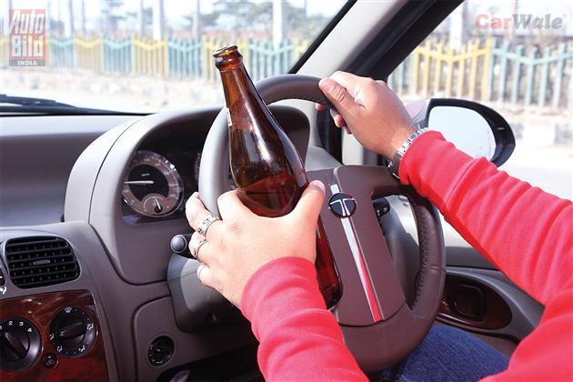
Road Traffic Digest 13
Drinking & Driving [Part I]
www.tsunamionroads.org

Slide 2
Alcohol is responsible for almost one third of traffic related deaths and half of all homicides in the world.
The life span of an alcoholic is shortened by an average of 15 years due to increased risk of :
Road accidents
Heart and liver diseases
Cancer &
Suicides
Experts say liquor raises the risk of as many as 60 diseases.
www.tsunamionroads.org

Slide 3
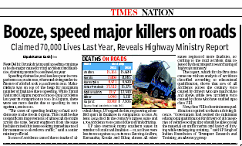
In India
Drunken driving is responsible for about 15% deaths due to road accidents. Considering present mortality of accidents as 1,36,834 [2011], more than 20,000 people are being killed every year in drunken driving.
60% of all injuries reporting to casualty at NIMHANS were related to alcohol
This is a very conservative estimate as other studies have suggested that in about 30-50% cases drivers were under the influence of alcohol [Bangalore- 44%, Delhi-33%, Kerala-50%]
www.tsunamionroads.org

Slide 4
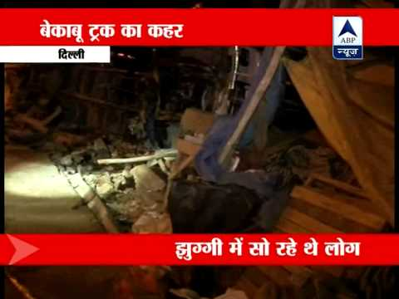
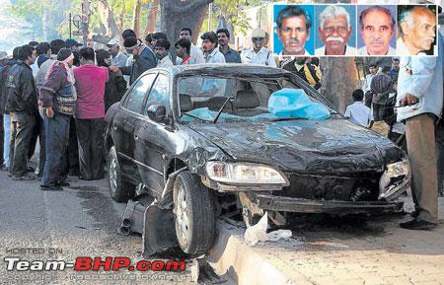
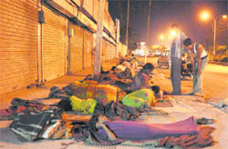
This data is only about drivers . There is no Indian data to show that besides drivers, how many deaths occur among other innocent road users or fellow passengers.
Like - - - -
Nobody knows how many poor pedestrians or poor laborers sleeping on footpaths are run over like insects or stray animals by drunken drivers - - - -
Speedy truck runs over three people
Four killed in Bangalore
www.tsunamionroads.org

Slide 5
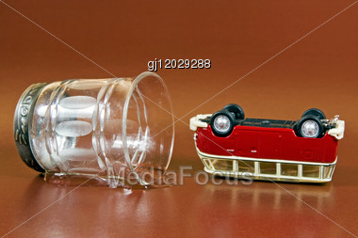
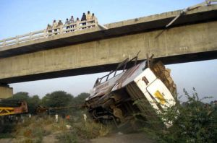
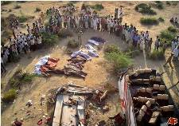
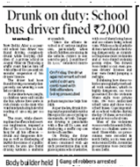
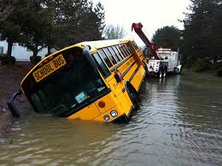
- - - and it is also not uncommon in India that a bus carrying fifty odd people falls into a river or a ravine causing death of most passengers just due to an intoxicated driver.
www.tsunamionroads.org

Slide 6
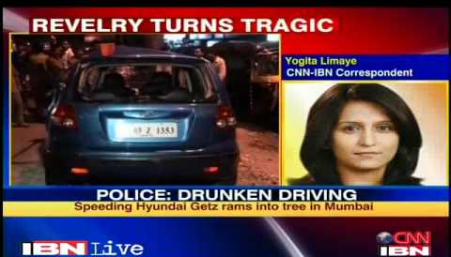
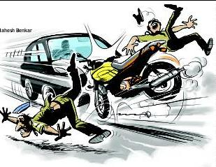
International data show that about equal number of casualties occur on roads among people other than drunken drivers themselves.
Here it is important to note that in developed countries where more than 90% people are inside cars that is considered to be much safer on the road. In Indian context where driving conditions are just the opposite, this mortality rate to non-drivers could be much higher.
www.tsunamionroads.org

Slide 7
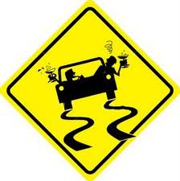
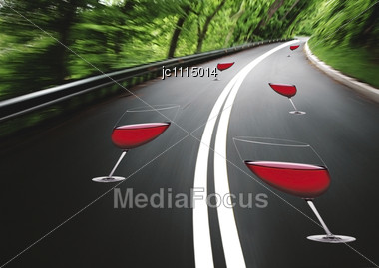
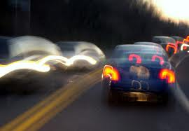
EFFECT OF ALCOHOL ON DRIVING
1. The interpretation and judgment power of the brain is affected. In case of some emergency, you have to take 4 to 5 decisions or actions simultaneously. While after alcohol one is able to deal only one thing at a time.
2. The brain-eye co-ordination that ensures an immediate and appropriate response during unusual situations on road is delayed by 20-30%.
3. The risk taking tendency increases under influence of alcohol like for over speeding or overtaking .
4. It causes blurred vision or reduces vision up to 25%.
www.tsunamionroads.org

Slide 8
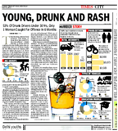
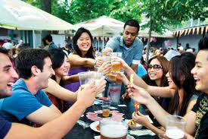
FACTORS AFFECTING FATALITY
AGE
For similar blood levels of alcohol, risk of accidents
among teenagers is 20 times more as compared to drivers
who are above 30 years.
New Delhi: A survey conducted by traffic police on drunk drivers in city has revealed that majority of those jailed this year were young, educated and driving private vehicles.
www.tsunamionroads.org

Slide 9
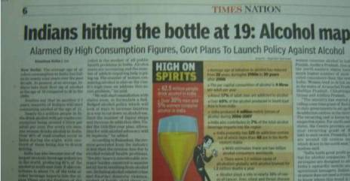
Why teenagers have 20 TIMES more risk for Accidents ??
They are relatively inexperienced consumers of
alcohol.
They are beginners having less driving experience.
Young people are under peer pressure to drink and
brag about their alcohol tolerance.
More chances of taking drugs along with alcohol
The most worrying fact today is that during last
20 years the average age at which people start drinking has come down from 28 years to 19.
www.tsunamionroads.org

Slide 10



MEN Vs WOMEN
Men can 'hold their drink' better than women
Women have 25% less tolerance as compared to males.
For the same body weight, women have more proportion of fatty tissue than men, so for the same amount of liquor consumed they reach a higher blood alcohol level.
www.tsunamionroads.org

Slide 11
THE DOSE Vs ACCIDENT RISK
Any level in blood above zero is associated with risk.
The risk of crash increases significantly at a BAC [blood alcohol concentration] level of 0.04g/dl.
A two-fold increase above legal limit increases the chances of accidents by 30 times.
In simple words, just one drink or one peg of alcohol (30ml of 42.8% by volume] is enough to impair your driving performance.
The Legal BAC Limit for driving in India is 0.03g/dl .
www.tsunamionroads.org

Slide 12
HOW MUCH CAN ONE DRINK SAFELY ???
Or
How to calculate your BAC level after consuming alcohol
Everywhere limits of alcohol consumption are mentioned in the form of BAC levels. For a lay man or a drinker it does not explain clearly about ‘how much amount of a particular drink with a particular alcohol concentration will roughly correspond to legal BAC level. So that law-abiding people who want to adhere to safe limit, should have a rough idea.
This is a practical problem that calls for attention of authorities.
Here is the formula - - - - - -
www.tsunamionroads.org

Slide 13
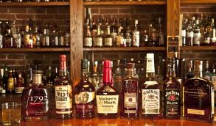
FORMULA FOR ‘HOW MUCH CAN ONE DRINK SAFELY’
[Widmark formula]
BAC level = Amount of Alcohol consumed in grams
Weight of the person X 10 X r
r = Widmark factor that is 0.7 for the man and 0.6 for the woman.
Example: Suppose an adult male having a weight of 70 kg consume 25 ml of whisky [having 42% alcohol weight by volume i.e. 42 grams in 100 ml of whisky], his BAC level would be:
BAC = 10.5 [alcohol in gm in 25 ml of 42% of whisky]
70 X 10 X 0.7
= 0.0214 gm/dl
Thus for a 70 kg male with a normal metabolism a BAC of .03 gm/dl will be achieved by 35 ml of whisky having 42% of alcohol or 300 ml of beer having 5% alcohol.
www.tsunamionroads.org

Slide 14
HOW TO COMBAT DRUNKEN DRIVING
The role of alcohol in traffic safety has generated more controversies than any other topic concerning road accidents. There are so many debatable issues regarding drunken driving not only in India but in the whole world.
Theoretical measures appear very simple, but mentioning them alone here is not the purpose of this digest. So an honest debate without any business motive and for the real benefit of society will help us to get better answers for this problem.
www.tsunamionroads.org

Slide 15

We believe if we really want any solutions for any kinds of social ills it is very important to resolve the controversies surrounding them before coming to actual measures.
So let us take these alcohol related controversies
one by one - - - - -
www.tsunamionroads.org

Slide 16
Controversy 1: Whether to Allow Drinking Before Driving?
We know that any level above zero is associated with a higher risk for an accident.
In other words, if we stick to ZERO BAC LEVEL, we could save 20,000 casualties on roads due to drunken driving and many more innocent commuters on roads [and the fate of their families].
Is this a small reward?
Certainly a figure of 20,000/year is much more as compared to casualties due to terrorist activities [700/year] ! !.
www.tsunamionroads.org

Slide 17
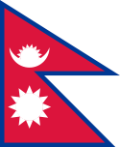










There are many countries[some are mentioned below] in the world that take this fact seriously and do not allow drinking before driving or follow a zero BAC limit .
Saudi Arabia
Nepal
Indonesia
Hungary
Japan
Nigeria
UAE
Uzbekistan
Bangladesh.
Slovakia
Czech Republic
Unfortunately, India is not one of them !
www.tsunamionroads.org

Slide 18
Controversy 2: If Drinking Allowed Then What Should be the Limit?:
Quite surprisingly there is no universal agreement all over the world on legal or maximum BAC level. It ranges from 0.02 to 0.1g/dl in various countries.
What does it show?
Don’t they know that control over dose of alcohol directly means control on accidents? Does it suggest that alcohol dependence or addiction is more important than lives on roads?
Don’t they all know that as compared to zero BAC the risk of a fatal crash with 0.05, 0.08 and 0.1g/dl is 1.8, four and six times respectively?
www.tsunamionroads.org

Slide 19
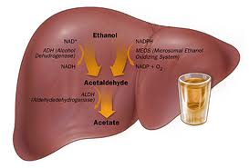
WHY THIS DUOBLE STANDARDS ??
it is a scientifically proven fact that
therapeutic dosage of a drug is same
on any human body all over the world
irrespective of race, religion or country.
Similarly, side-effects or lethal effects of any drug appear at same level in blood in all human beings.
Have you heard that dose of any antibiotic or antipyretic is different in different countries??
If the toxic levels for various drugs in all human beings are fixed for all countries, then why are there double standards in the case of alcohol?
www.tsunamionroads.org

Slide 20

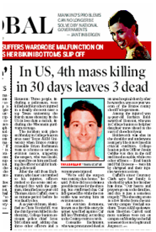

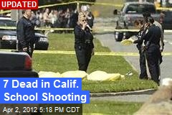
Perhaps, some developed countries having a very high BAC limit feel that like open arms license policy, there is no need for a rigid control over BAC, as their citizens especially teenagers are ‘mature enough’ to use these liberties ‘judiciously and safely’! !
www.tsunamionroads.org

Slide 21
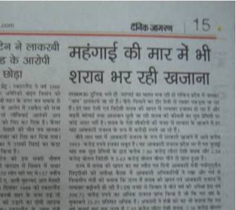
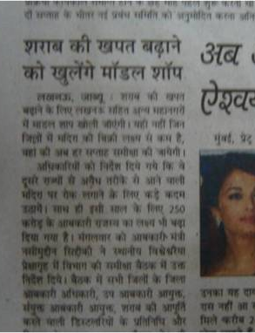

Controversy 3: Revenue and Liquor
Alcohol sale is a major source of revenue for most State Govts and they try their best to boost sales every year.
More model shops to boost liquor sale
Huge revenue by liquor despite high inflation
The government says that there is no vested interest behind this. It even claims that the revenue generated from alcohol industry is less than the revenue loss in treating the alcohol related health problems.
www.tsunamionroads.org

Slide 22
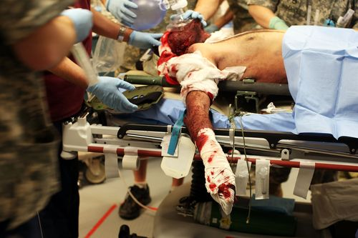
However, it is a fact that revenue from alcohol [approx. 35000 crore] directly goes to Govt while most expenses towards treatment of alcohol related problems comes directly from pockets of sufferers and NOT from treasure of Indian Government !!
FACTS:
More than 80% trauma patients are
treated in private hospitals
&
In India only 2-3% population has
medical insurance
www.tsunamionroads.org

Slide 23
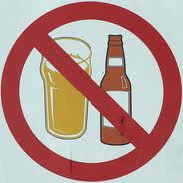
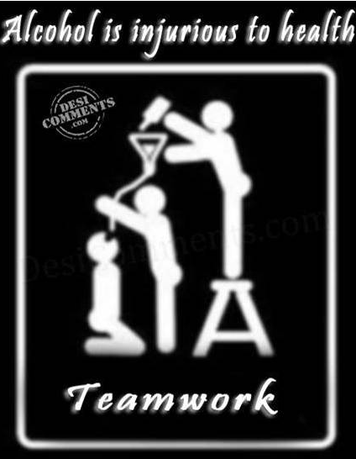
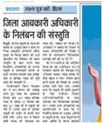
Controversy 4: Is there any Need for Prohibition Department :
In India, there is ministry of Social Justice to curb use of alcohol.
While on one hand there is an Excise dept. that tries its best to boost liquor sales. We clearly see that Excise dept is dominant over prohibition dept.
District Excise Officer suspended for not achieving sale target for liquor
www.tsunamionroads.org

Slide 24
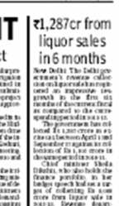
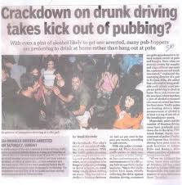
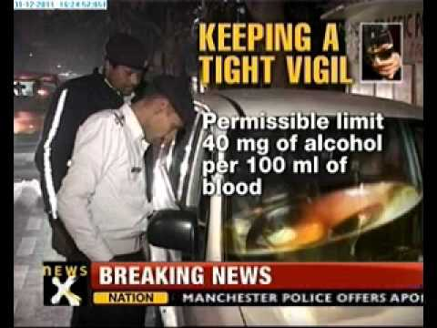
This is like adding sprit to a fire and alternately trying to put water to douse it. For example - - -
On one hand - -
CM Sheila Dixit increases target of liquor tax to Rs 3000 crore for 2012-13 !
On the other hand - -
The same Govt ask traffic police to intensify drive against drunken driving!!
www.tsunamionroads.org

Slide 25
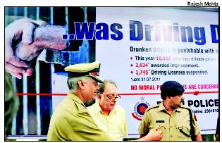
The poor traffic police has no choice but to manage all the ill effects of Liquor boost
www.tsunamionroads.org

Slide 26
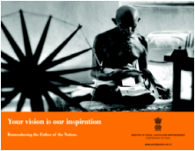
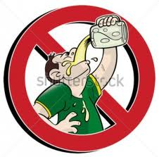
The prohibition department is probably just a formality or to appease the soul of a saint like Mahatma Gandhi.
This dept spends a fat amount on publicity to educate people, but It’s effect on public remains doubtful. Kerala has the maximum literacy rate in India and yet Keralites consume the maximum amount of liquor in India [just double the average Indian per capita consumption of 4 litres/yr] and have a very high accident rate due to alcohol.
www.tsunamionroads.org

Slide 27
Controversy 5: Who are the liquor policy-makers by the way?
Do the policy-makers include intellectual people from all sections of society or just a few officials and influential politicians?
[1] Do we have enough female representatives?
Since males are involved in more than 85% cases of drunken driving, it is women who suffer most after death of bread-winner of the family.
Do we have enough female representatives for such policy matters? If not, it would again support the view that Indian society or Indian politics is a male dominated one.
www.tsunamionroads.org

Slide 28
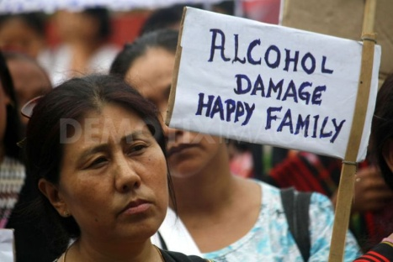
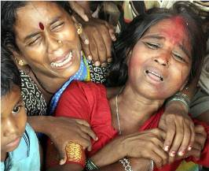
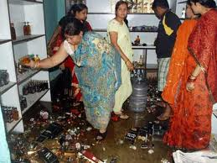
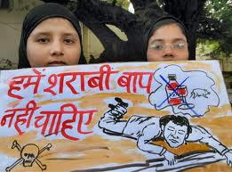
If we talk in broader terms beyond road accidents, we see that alcoholism is also largely responsible for majority of cases of domestic violence in all classes of society. Among lower income groups, wives of drunkards not only face physical abuse but also face great financial constraint in running the house hold.
www.tsunamionroads.org

Slide 29
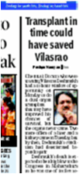
[2] Is there proper representation from doctors amongst the policy makers?
Accidents after alcohol have a high fatality and physical disability rate. More than 60-70% have neurotrauma leaving thousands permanently crippled mentally !
As a doctor we can say, it is extremely difficult to treat alcohol-related diseases. Terminal liver disease is incurable and unlike kidney transplant, liver transplant is out of reach for the majority in India.
www.tsunamionroads.org

Slide 30
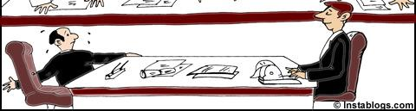

As regards the govt officials or ministers, their views on alcohol policy keep on changing.
For example,
[1] An excise official will have different views as compared
to one from prohibition dept. If the same officer changes
dept, his views may change drastically. This is probably
due to the fact that commitment to his post is more
important than the society.
[2] Similarly, views of politicians depend on the fact whether they are in power or in opposition.
www.tsunamionroads.org

Slide 31
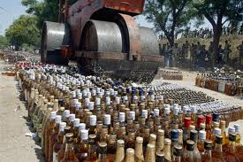
Controversy 6: Revenue is Must for Development:
Often Govt accepts that revenue is extremely necessary for development of State itself. Seems true! Gujarat is among four States which follow prohibition. Despite this Gujarat is one of the few States that are making fast developments in all fields !
What does it show? Can’t the State find some alternative means of revenues? Are taxes the only means of earnings for the State? Should we not place more stress on productivity or industrialization for improving our economy?
Bulldozing liquor bottles in Gujarat
www.tsunamionroads.org

Slide 32
In the next digest we will consider about what are the legal and social measures available or what is the role of Govt. authorities and society for controlling drunken driving.
www.tsunamionroads.org

Slide 33
You have received this message from the 'Tsunami on Roads Organization' as a part of an awareness campaign against road traffic hazards. If you find any merit in this message, please forward it to your contacts.
From
Conscious Citizens, India
[www.tsunamionroads.org]
• For the previous digests please visit: www.tsunamionroads.org/rtd.html
or www.scribd.com or www.slideshare.net
• To receive such digests in future please inform us at: consciouscitizensindia@gmail.com
www.tsunamionroads.org

Slide 34
In future, besides road accidents, the following topics will also be discussed on this platform :
How to decongest our cities
Vehicle induced environmental pollution
Arrogance on Roads: Aggressive driving and Road rage
Public Attitude towards traffic rules in the City
Problems of pedestrians
Road traffic and global warming
The economics of vehicles
Petroleum Subsidy: Right or Wrong?
Biography of urban roads in India
Traffic Policeman: Problems & Challenges

Slide 35

Jai Hind
www.tsunamionroads.org

